Slide 1
Triple Integrals (rectangular) Q&A

Slide 2
Is density the most common use of triple integrals in physical applications? What other applications are commonly used?

Slide 3
Could you describe how to intuitively think about triple integrals as mass from density?

Slide 4
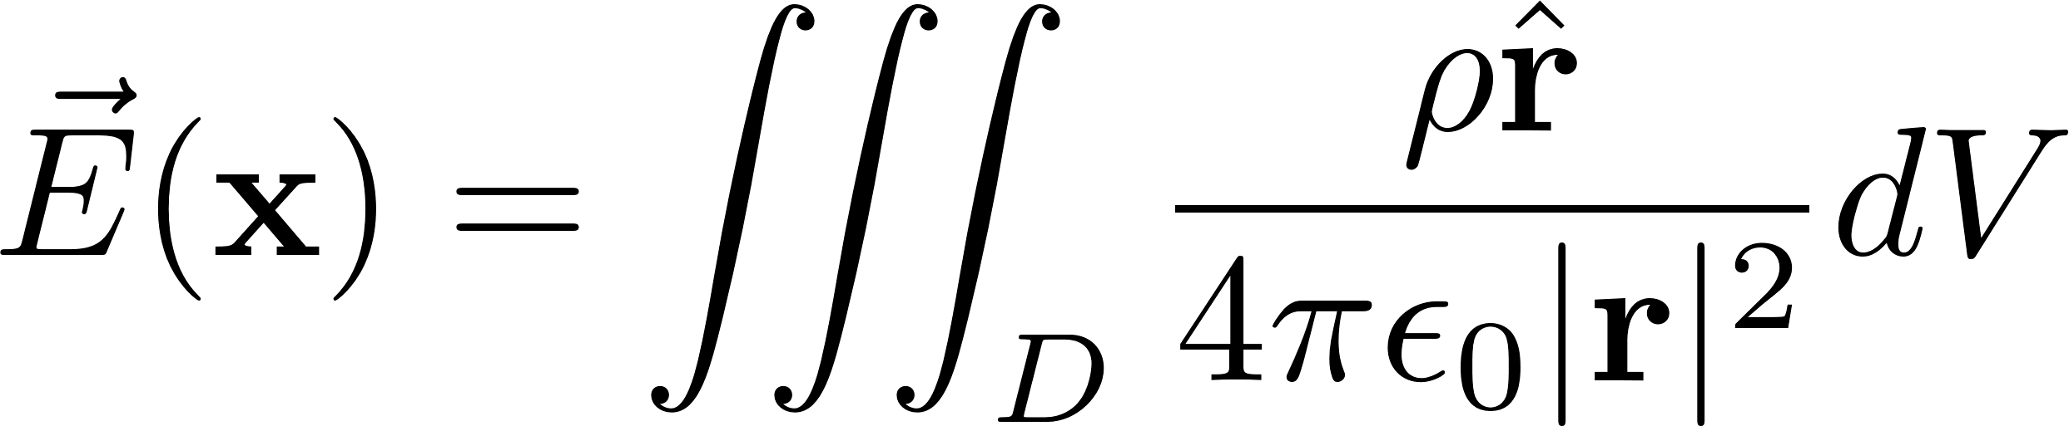

What parameters do you integrate with respect to with $\overset{⃑}{E}$?

Slide 5
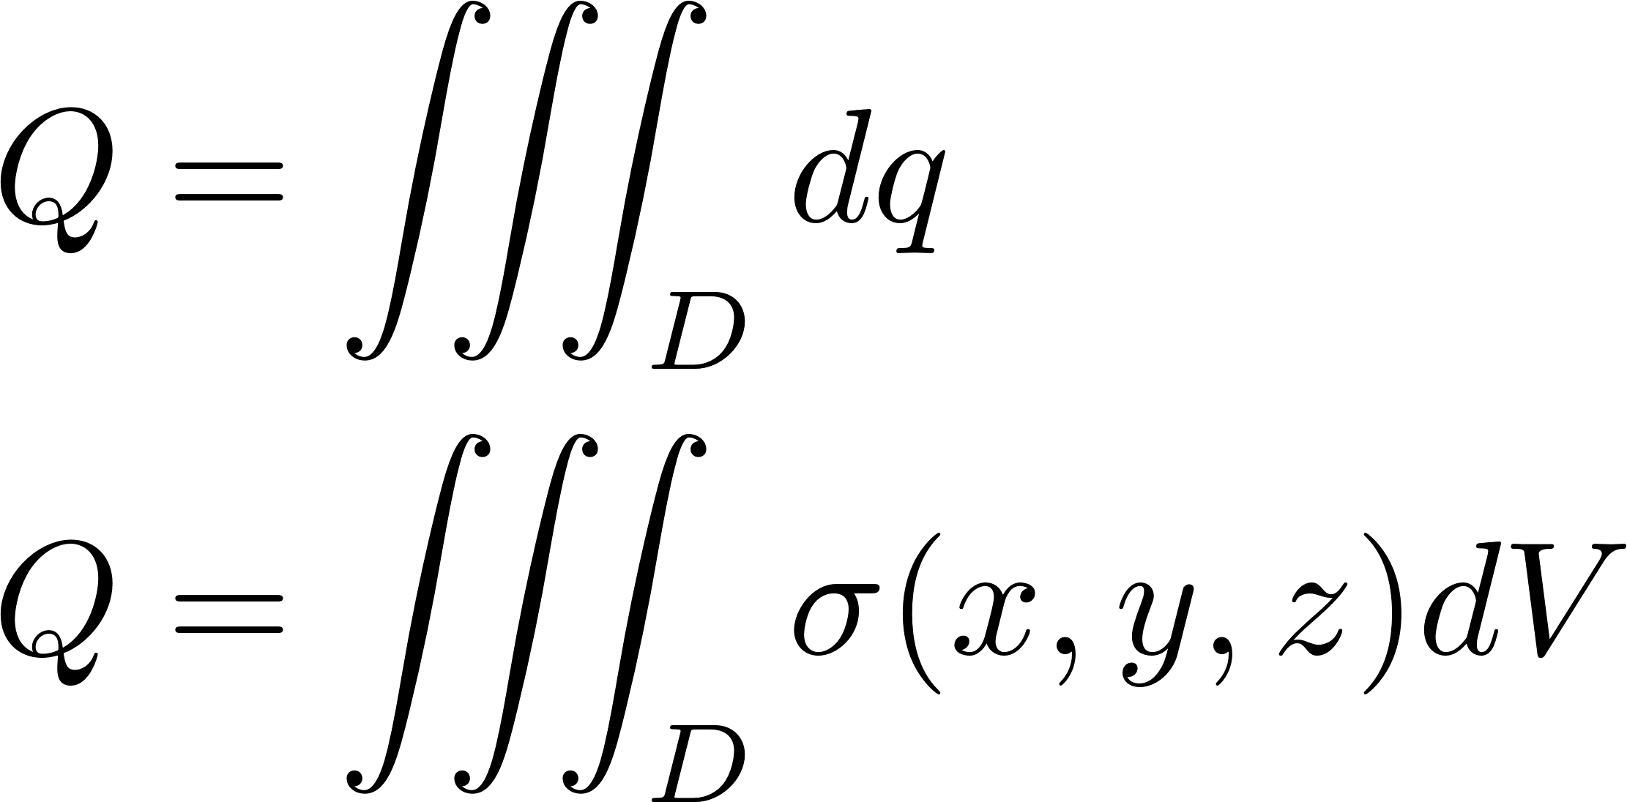
How do you get Charge from Density?

Slide 6
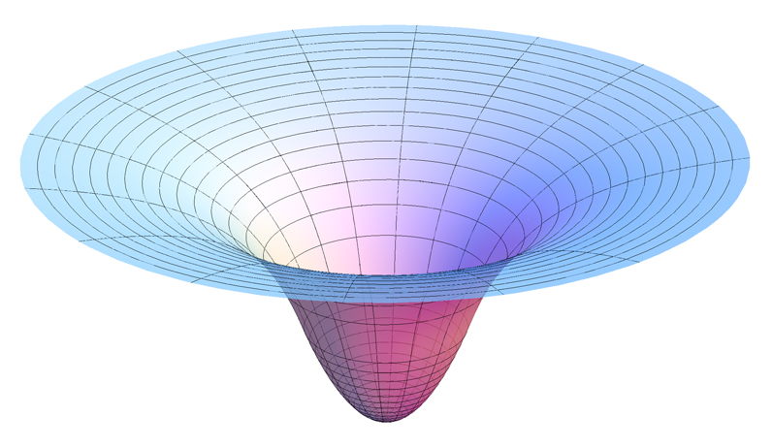
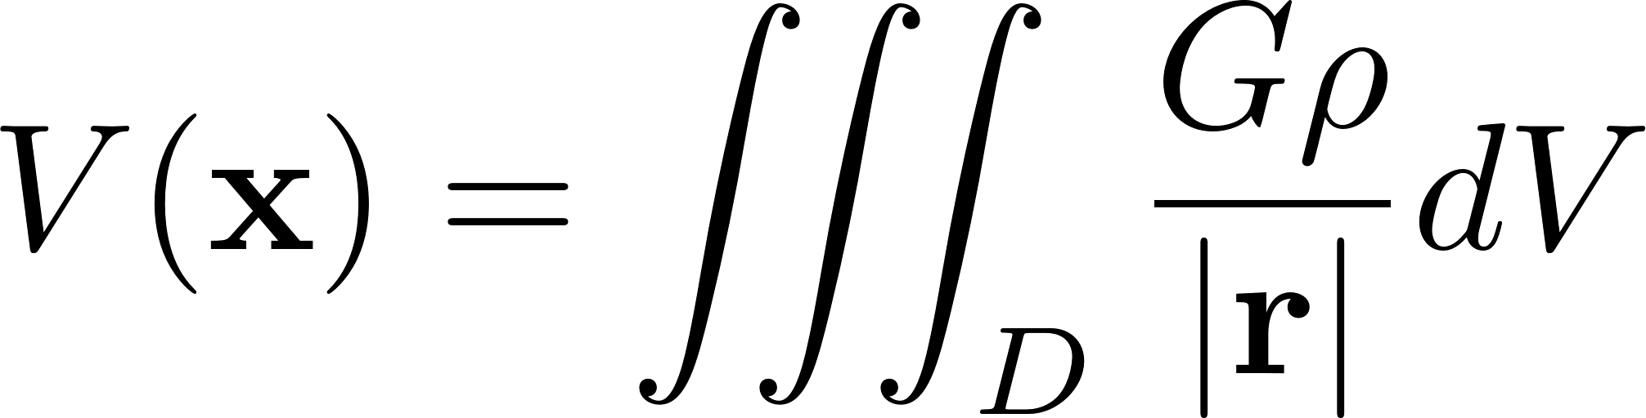

When does $r$ vary in gravitational potential?

Slide 7
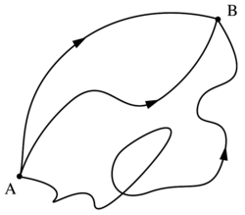
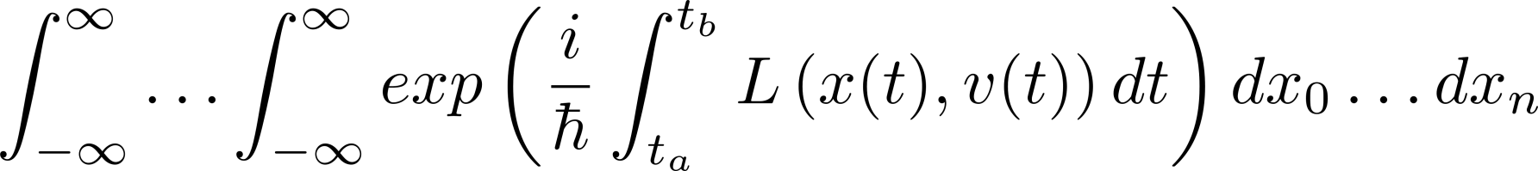
Do all quadruple integrals relate to time? What are some other specific ways higher order integrals come into play?

Slide 8
Triple Integrals (Cylindrical & Spherical)

Slide 9
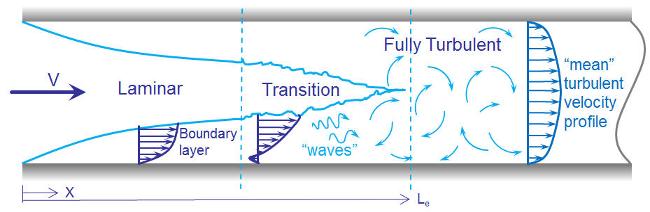
Fluid Flow in Pipes

Slide 10
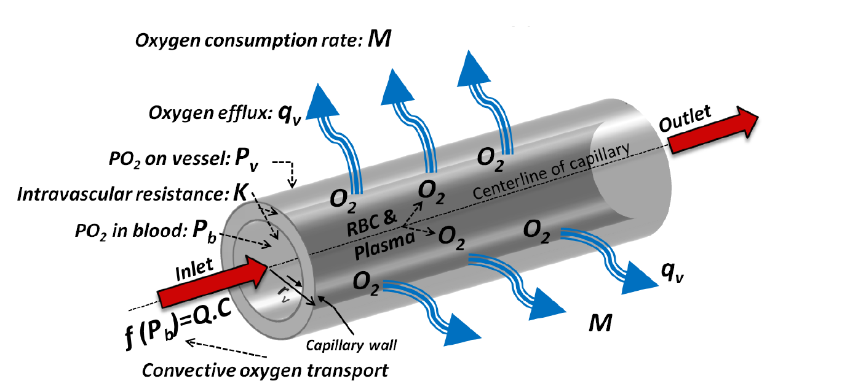
Solute Diffusion

Slide 11
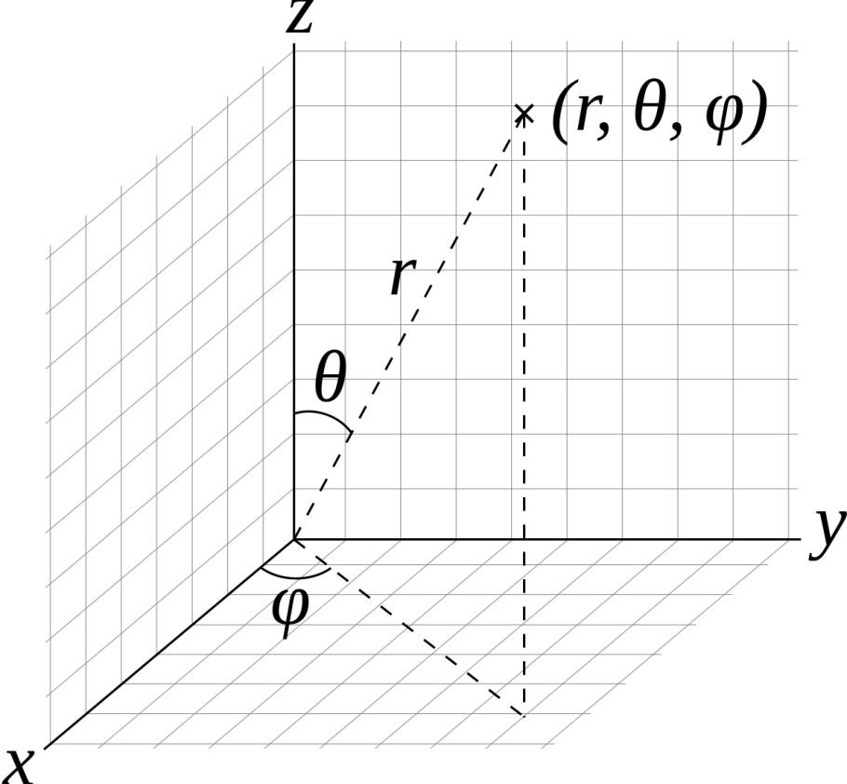
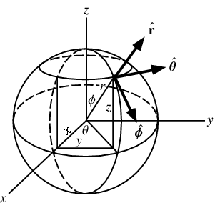
Conventions
Math convention
Physics convention
(ISO standard 80000-2)

Slide 12
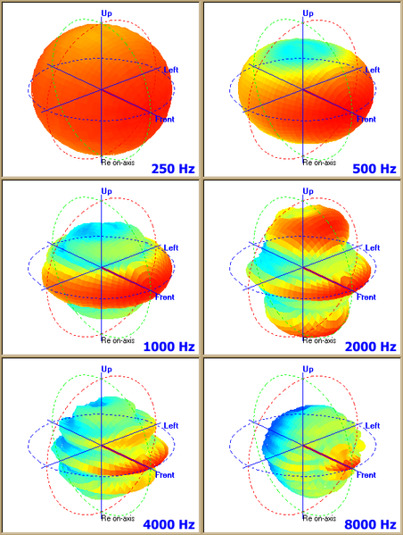
Loudspeaker Patterns

Slide 13
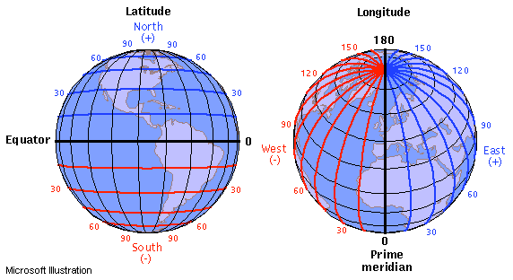
Latitude & Longitude

Slide 14
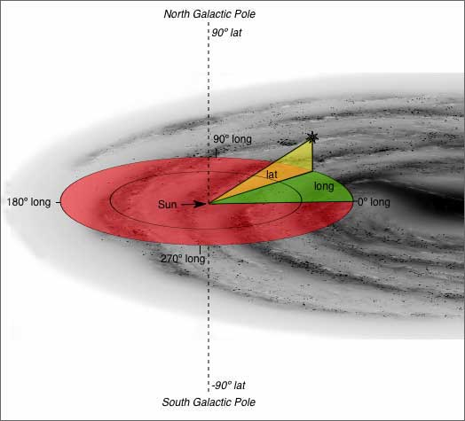
Galactic Coordinates

Slide 15
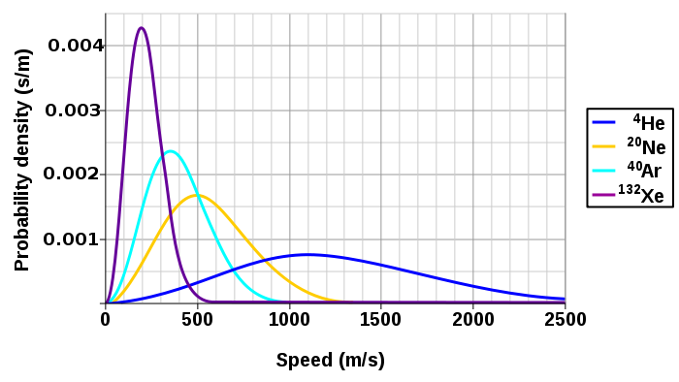
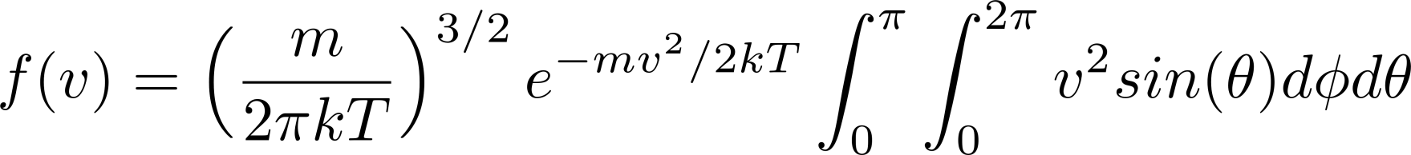
Maxwell-Boltzmann Distribution

Slide 16
Schrodinger Equation

